Slide 1
Identifying location of potholes using computer vision
ATRIA INSTITUTE OF TECHNOLOGY
DEPARTMENT OF COMPUTER SCIENCE AND ENGINEERING

Slide 2
Project Guide
PROF. Sathisha G
Team Members
01.
1AT19CS007
AFIFA MAHEEN
02.
1AT19CS018
ARVIND KUMAR
03.
1AT19CS020
ASHITHA V SHETTY
04.
1AT19CS055
KAVYA J K

Slide 3
01.
Description of the project
Contents
02.
The Domain
03.
Requirement Analysis
04.
Methodology

Slide 4
Description Of The Project
Potholes, has caused drivers substantial money-related harm each year.
In India lot of accidents are happening due to the careless driving.
To save the people from the road accidents we need to develop an attention based driving system using deep learning.
To detect the sign boards we are using Yolov4 model.
To detect potholes we will use the R-CNN algorithm and SSD mobile net algorithm.
Our system will detect the potholes and signboards and make voice alert to the driver to drive safely.

Slide 5
The Domain

Slide 6
DEEP LEARNING
Deep learning (also known as deep structured learning) is part of a broader family of machine learning methods based on artificial neural networks with representation learning. Learning can be supervised, semi-supervised or unsupervised.
Deep-learning architectures such as deep neural networks, deep belief networks, deep reinforcement learning, recurrent neural networks, convolutional neural networks and Transformers have been applied to fields including computer vision, speech recognition, natural language processing, machine translation, bioinformatics, drug design, medical image analysis, climate science, material inspection and board game programs, where they have produced results comparable to and in some cases surpassing human expert performance.

Slide 7
REQUIREMENT ANALYSIS

Slide 8
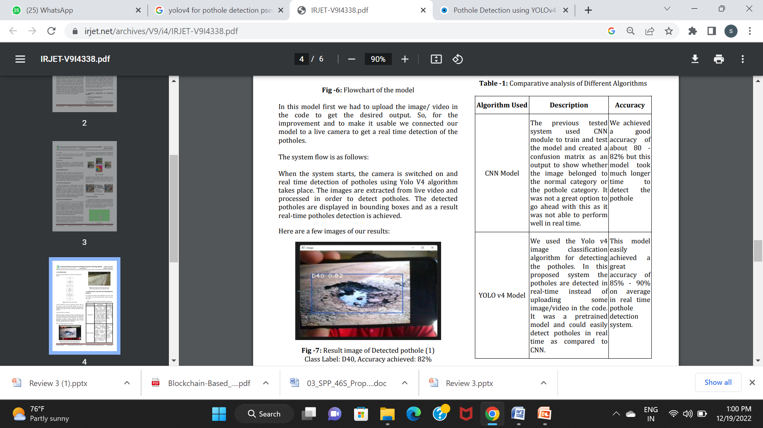
COMPARISION WITH EXISTING SYSTEM

Slide 9
REQUIREMENTS OF THE PROJECT
SOFTWARE: Python
OPERATING SYSTEM: Windows, Linux or Mac OS X
CPU: Intel Core i5 10th gen or above
RAM: 8 GB
STORAGE: 120 GB

Slide 10

VS-code
Visual Studio Code, also commonly referred to as VS Code, is a source-code editor made by Microsoft with the Electron Framework, for Windows, Linux and macOS. Features include support for debugging, syntax highlighting, intelligent code completion, snippets, code refactoring, and embedded Git. Users can change the theme, keyboard shortcuts, preferences, and install extensions that add additional functionality.

Slide 11

Python
Python is a high-level, general-purpose programming language. Its design philosophy emphasizes code readability with the use of significant indentation.
Python is dynamically-typed and garbage-collected. It supports multiple programming paradigms, including structured (particularly procedural), object-oriented and functional programming. It is often described as a "batteries included" language due to its comprehensive standard library.

Slide 12
Methodology

Slide 13
THE PROPOSED APPROACH
The main objective of this work is to develop a system that can detect potholes from images. This pothole detection could be done in real time. For this, a deep learning-based approach has been used. A convolutional neural network (CNN)-based model has been designed that takes as input- images of potholes and non-pothole roads. After training the model on this data, the model predicts if the input image is of a pothole or non-pothole. The convolutional neural networks have been used in various fields such as radiology, for tasks like classification, object detection, segmentation etc. Further, we have used pretrained neural network models based on residual networks for obtaining better results for the given task. However, we have not used the pre-trained models just off-the-shelf.

Slide 14
CNN based Yolov4
The YOLO V4 algorithm is used in the suggested system. "You Only Look Once" is the acronym meaning "You Only Look Once." It is a state-of-the-art, real-time object identification system developed by Joseph Redmon that can distinguish several items in a single frame. YOLO takes a completely different technique to detection than earlier technologies. It uses a single neural network to process the entire image. The image is divided into regions by this network, which predicts bounding boxes and probabilities for each region. The projected probabilities are used to weight these bounding boxes.

Slide 15
CNN based Yolov4
We will train the YOLOv4-Tiny model with a fixed resolution of 416×416.
Then we will carry out dynamic resolution training using the YOLOv4-Tiny model with a base resolution of 416×416. This experiment should give us a higher mAP on the test set than the fixed-resolution training. We will confirm so when analyzing the results.
Next, we will train a dynamic resolution model using the YOLOv4 model with a base resolution of 608×608. This, again, should give us a higher mAP on the test set compared to the tiny models.
Finally, we will carry out fixed-resolution training for the YOLOv4 model with an image resolution of 608×608.

Slide 16
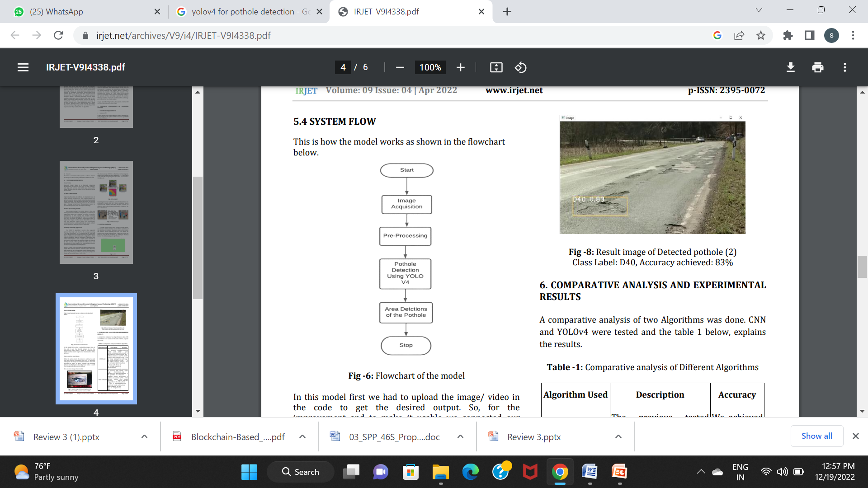

SYSTEM DESIGN

Slide 17
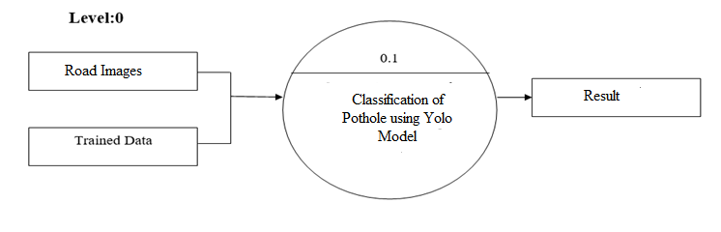
SYSTEM DESIGN DFD LEVEL-0
Level: 0 describes the overall process of the project. We are user’s road images and trained as input. By using the deep learning algorithm, it will efficiently detects potholes in input image.

Slide 18
SYSTEM DESIGN DFD LEVEL-1
1.1
Preprocess
1.2
Extract Features
Images
Features
Level: 1 describes the first step of the project. We are passing images as input system will prpeprocess and extract image features.

Slide 19
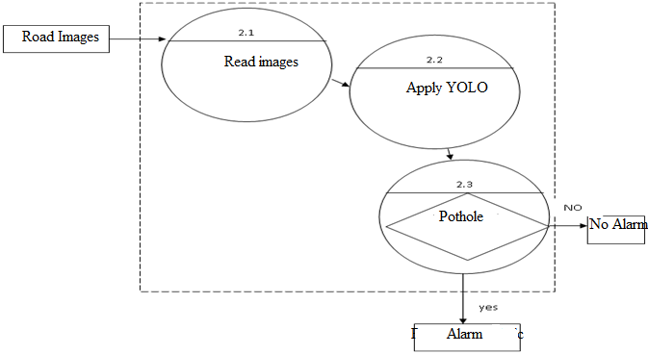
SYSTEM DESIGN DFD LEVEL-2
Level: 2 describes the final step of the project. We are passing images as input system will read the road image and detect potholes using YOLOv2.

Slide 20
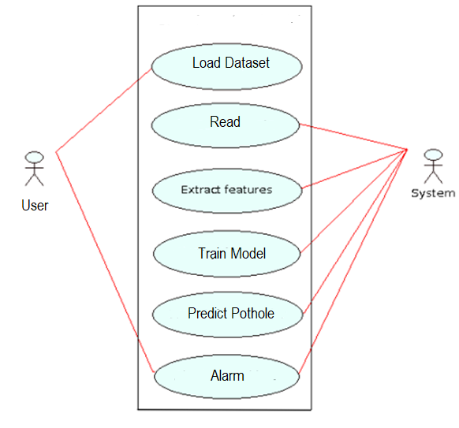
SYSTEM DESIGN Use Case Diagram
User Case diagram represents the user interaction with our application.

Slide 21
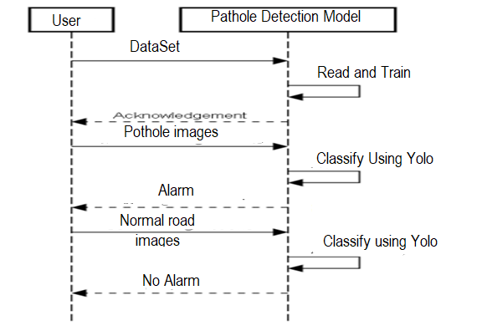
SYSTEM DESIGN SEQUENCE DIAGRAM
Sequence diagram represents active and inactive stages of every users.

Slide 22
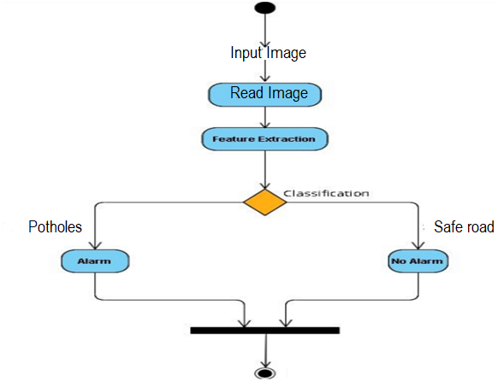
SYSTEM DESIGN ACTIVITY DIAGRAM

Slide 23
SYSTEM DESIGN CLASS DIAGRAM
User
dataset: image
Start()
Listen Alarm()
System
dataset: image
capture image()
Preprocess()
Pothole detection()
Play alarm()

Slide 24
IMPLEMENTATION
We have used the following modules to build our project
Data Collection
Data preprocessing
Building and training Yolo model
Prediction of potholes

Slide 25
IMPLEMENTATION
Data Collection:
We are collecting the pothole dataset from kaggle.com. Our dataset Contains two types of images i.e images with the pothole roads and images with good conditional roads. Each class contains 340 images.

Slide 26
IMPLEMENTATION
Data Pre Processing:
The collected dataset images will be in different size so we need to change into the fixed size to given the input to the training model so we are using the opencv resize function to change into fixed size of 224x244.

Slide 27
IMPLEMENTATION
Building And Training of YOLO:
The proposed deep YOLO dark-net will be trained on the processed dataset. Hence, the trained model will be used in an online phase (real driving application) to predict road is safe or unsafe while driving. Yolo v3 is used especially in multiclass classification.

Slide 28
IMPLEMENTATION
Prediction of Driver State:
This project proposed a deep Yolo v3 technique to detect the potholes or no pothole if it is potholes our system will make alarm. Performance results prove that the proposed scheme yielded the highest accuracy, over more than 98%, compared to the others in which the Yolov3 is used as a single model without any combination.

Slide 29
TESTING
Test Case# | TC01
Test Name | User input format
Test Description | To test input image
Input | Road frame captured through camera
Expected Output | Display the frame in the monitor
Actual Output | Displayed the frame
Test Result | Success

Slide 30
TESTING
Test Case# | TC01
Test Name | User input format
Test Description | To test input image
Input | No road image
Expected Output | Show idle state
Actual Output | Showed idle state
Test Result | Success

Slide 31
TESTING
Test Case# | UTC03
Test Name | Preprocess
Test Description | To test image is resized or not
Input | Road images
Expected Output | Resize the image to train model
Actual Output | Image resized
Test Result | Success

Slide 32
TESTING
Test Case# | UTC04
Test Name | Pothole Detection
Test Description | To detect pothole from input frame
Input | Road image
Expected Output | It Should detect pothole
Actual Output | It detected the pothole
Test Result | Success

Slide 33
TESTING
Test Case# | UTC05
Test Name | Test case for importing valid python libraries
Test Description | To test whether an algorithm to implement congestion nodes works without sklearn and keras models
Input | Import all valid libraries sklearn, tensorflow, and keras libraries
Expected Output | An error should be thrown specifying “error importing libraries sklearn, tensorflow and keras libraries”
Actual Output | An error is thrown
Test Result | Success

Slide 34
BATCH NO:12
LITERATURE SURVEY

Slide 35
A COMPARATIVE EVALUATION OF THE DEEP LEARNING ALGORITHMS FOR POTHOLE DETECTION
JOURNAL:
IEEE
SUMMARY
FINDINGS
Potholes are a menace on roads and their presence compromises the safety of both drivers and pedestrians.
A simple and efficient way to detect potholes on roads is through the application of object detection algorithms on images acquired from user.
Therefore in this paper, we focus on evaluating the performance of state-of-the-art neural network algorithms such as YOLO and Faster R-CNN with VGG16 and ResNet-18 architectures for pothole detection that is both fast and accurate.
The results showed that the modified YOLOv2 architecture outperformed all the other considered models.
To compare the existing state-of-the-art deep learning architectures.
To develop a modified YOLOv2 architecture to deal with class imbalance problem.
DATE:
13 DEC 2020
LINK:
https://ieeexplore.ieee.org/document/9342558
METHODOLOGY
YOLO object detection algorithm
Faster Region-based Convolutional Neural Networks)

Slide 36
Similarities and Differences
SIMILARITIES
DIFFERENCES
Performance evaluation is carried out using precision, recall, number of frames processed per second (FPS), and IoU (Intersection over Union).
Images and videos of “pothole” and “normal road” were acquired with smartphones

Slide 37
DEEP LEARNING BASED DETECTION OF POTHOLES IN INDIAN ROADS USING YOLO
JOURNAL:
IEEE
SUMMARY
FINDINGS
In countries like India road maintenance is a challenging task. Year after year, the accident rates are increasing due to the up-surging potholes count.
In recent trends, many approaches proved good results in applying deep learning for different object detection. Convolutional Neural Networks (CNNs) have the ability to learn the art of extracting relevant features from an Image. But in countries like India, there is no potholes dataset available to train the CNN.
In this paper, a new 1500 image dataset has been created on Indian roads. The dataset is annotated and trained using YOLO (You Only Look Once).
The new dataset is trained on YOLOv3, YOLOv2, YOLOv3-tiny, and the results are compared. The results are evaluated based on the precision and recall etc. The model is tested on different pothole images and it detects with a reasonable accuracy
The quality of the images is taken care of as it plays a major role in the deep learning process.
DATE:
28 Feb 2020
LINK:
https://ieeexplore.ieee.org/document/9112424
ALGORITHMS
YOLO with different versions.

Slide 38
Similarities and Differences
SIMILARITIES
DIFFERENCES
Totally 1500 image dataset is trained using various versions of YOLO.
Furthermore, the mean average precision is improved by making suitable architectural changes.
The results are evaluated based on the map , precision and recall .
The model is tested on different pothole images and it detects with a reasonable accuracy

Slide 39
DETECTION OF ROADS POTHOLES USING YOLOV4
JOURNAL:
IEEE
SUMMARY
FINDINGS
Road connectivity is most important for developing nations. A great challenge is to detect road damage which manually causes huge costs by putting different resources, such as technical devices.
A country like India where transportation is a lifeline for the economy. It has seen that most of the road damages arises due to potholes.
Cost effective approach has to be considered to detect potholes. CNN has ability to extract the relevant features from image or video based datasets.
In this paper, pothole image dataset annotated and trained using YOLOv4 and results were evaluated based on recall, precision and MAP. The model was validated with different set of images and videos based on potholes.
Mainly accomplished by Deep Learning based YOLOv4 algorithm.
The image dataset based trained model is also successfully applied to video samples for the detection of potholes.
DATE:
08 NOV 2020
LINK:
https://ieeexplore.ieee.org/document/9351373
METHODOLOGY
YOLOv4 object detection algorithm.

Slide 40
Similarities and Differences
SIMILARITIES
DIFFERENCES
CNN has ability to extract the relevant features from image or video based datasets.
Performance evaluation is carried out using precision, recall, number of frames processed per second (FPS), and IoU.
Images and videos of “pothole” and “normal road” were acquired with dataset from Kaggle.

Slide 41
Importance of Contextual Information for the Detection of Road Damages
JOURNAL:
IEEE
SUMMARY
FINDINGS
The objective is to improve the optical detection of road damages, especially potholes, based on images from windscreen mounted monocular cameras, as well as to reduce the complexity .
Thus two different parts were implemented and analyzed:
A semantic segmentation for classifying the contextual information
A pothole detection.
First, different semantic segmentation networks are compared by varying the training dataset
In the second step, this segmentation into road and potholes.
In addition, our results show that deep learning (DL) approaches need at least a simplified contextual information.
The quality of the images is taken care of as it plays a major role in the deep learning process.
DATE:
12 SEPT 2020
LINK:
https://ieeexplore.ieee.org/document/9242954
ALGORITHMS
Deep learning (DL) approaches

Slide 42
Similarities and Differences
SIMILARITIES
DIFFERENCES
This paper proposed and analyzed the importance of contextual information on the detection of road anomalies and damages
Uses images from window screen mounted cameras.
Semantic Segmentation and Image Processing is used.

Slide 43
A Review on Negative Road Anomaly Detection Methods
JOURNAL:
IEEE
SUMMARY
FINDINGS
The main limitation to obstacle nowadays has been negative road anomalies which is the term we used to refer to potholes and cracks due to their negative drop from the surface of the road.
This has for long been a limitation because of the fact that they exist in different, random and stochastic shapes.
Today's technology lacks the presence of sensors capable of detecting negative road anomalies efficiently as the latter surpasses the sensor's limitations rendering the sensing technique inaccurate.
A significant amount of research has been focused on the detection of negative road anomalies
In this paper, the existing techniques will be reviewed.
Current research has been extensively focusing on machine vision more than the other techniques.
DATE:
20 Mar 2020
LINK:
https://ieeexplore.ieee.org/document/9043541
METHODOLOGY
Deep Learning Techniques
CNN

Slide 44
Similarities and Differences
SIMILARITIES
DIFFERENCES
This system can be efficient with some slight modifications
It relies on images and videos from processing it .
Semantic Segmentation and Image Processing is used.

Slide 45
Detection and counting of pothole using image processing techniques
SUMMARY
FINDINGS
Different image segmentation techniques.
JOURNAL:
IEEE
Pothole are the primary cause of accidents, hence identification and classification using image processing techniques is very important.
In this paper image pre-processing based on difference of Gaussian-Filtering and clustering based image segmentation methods are implemented for better results.
The main goal of this paper is to identify a better method which is highly efficient and accurate compared to the conventional methods. Different image pre-processing and segmentation methods for pothole detection where reviewed using performance measures.
DATE:
08 May 2017
ALGORITHMS
LINK:
https://ieeexplore.ieee.org/document/7919622
Edge detection technique
Thresholding technique based on Otsu’s method
K-Means based Image clustering technique
Fuzzy C-Means based Image clustering technique

Slide 46
Similarities and Differences
SIMILARITIES
DIFFERENCES
Pot holes on road will make transportation
slower and costly.
Different image segmentation techniques

Slide 47
Detecting road potholes using computer vision techniques
JOURNAL:
IEEE
SUMMARY
FINDINGS:
Different object detection techniques and evaluate which algorithm would be best
The number of road potholes is growing day by day due to the increase in vehicles. This is also increasing the number of vehicle accidents caused by lack of road maintenance.
In this paper we show that the model with the best performance is YOLOv3 SPP, but if time is a priority, the SSD TFLite model is the right fit.
DATE:
26 November 2020
ALGORITHMS
You only look once(YOLO) .
Single shot detector(SSD).
LINK:
https://ieeexplore.ieee.org/document/9266138

Slide 48
Similarities and Differences
SIMILARITIES
DIFFERENCES
Deep learning algorithms which
can detect potholes on the road automatically.
The experimental results show that
the YOLO V3 model performs best for its faster and more reliable detection results.

Slide 49
Pot-holes detection on Indian Roads using
Mobile Sensors
SUMMARY
FINDINGS
We can use this technology for the identification and patching the potholes.
JOURNAL:
IEEE
Pot holes on road will make transportation
slower and costly. India has a big network of roads to connect
the villages and cities, the authority persons cannot travel
across the region for identification of holes. As per
advancement in machine learning in recent time, we can use
this technology for the identification and patching the potholes.
As per the recent survey around 400millions, people
have a smartphone in India. We can use smartphone sensors
(such as Accelerometer and gyroscope) to identify the pot-holes
on road and GPS for the location of the pit. The major task of
this problem is to capture the data and annotation. We have
developed an android app for capturing the value of
displacement while travelling on road. We have applied
different classification algorithms to sensor raw-data. SVM is
the most suitable classification technique for this problem. The
android app will sound an alarm when a pothole is detectedPot holes
DATE:
June-2018
ALGORITHMS
LINK:
https://www.semanticscholar.org/paper/Pitfree%3A-Pot-holes-detection-on-Indian-Roads-using-Singal-Goswami/352dff9775ab93ef563a193f3364d1829cea5302
Support Vector
Machine.
Naïve Bias.
Logistic Regression

Slide 50
Similarities and Differences
SIMILARITIES
DIFFERENCES
Pot holes on road will make transportation
slower and costly.
This technology for the identification and patching the potholes.

Slide 51
A Deep Learning Approach for Street Pothole Detection
JOURNAL:
IEEE
SUMMARY
FINDINGS:
We propose an efficient pothole detection system using machine learning algorithms which can detect potholes on road
.
Potholes are a structural damage to the road
with hollow which can cause severe traffic accidents and
impact road efficiency. In this paper, we propose an efficient
pothole detection system using deep learning algorithms which
can detect potholes on the road automatically. Four models are
trained and tested with preprocessed dataset, including YOLO
V3, SSD, HOG with SVM and Faster R-CNN. In the phase one,
initial images with potholes and non-potholes are collected and
labeled. In the phase two, the four models are trained and
tested for the accuracy and loss comparison with the processed
image dataset. Finally, the accuracy and performance of all
four models are analyzed. The experimental results show that
the YOLO V3 model performs best for its faster and more
reliable detection results.
DATE:
29/08/2020
ALGORITHMS
You only look once(YOLO) .
Single shot detector(SSD).
Histogram of oriented gradients(HOG) with support vector machin. .
LINK:
https://ieeexplore.ieee.org/document/9179558

Slide 52
Similarities and Differences
SIMILARITIES
DIFFERENCES
Deep learning algorithms which
can detect potholes on the road automatically.
The experimental results show that
the YOLO V3 model performs best for its faster and more reliable detection results.

Slide 53
Deep Learning Approach to Detect Potholes in Real-Time using Smartphone
JOURNAL:
IEEE Pune Section
SUMMARY
FINDINGS
Detection, and mapping of potholes in a precise and punctual manner is an essential task in avoiding road accidents. Today, roadway distresses are manually detected, which requires time and labor.
we introduce a system which uses deep learning algorithms and is integrated with smartphones to detect potholes in real-time.
A deep learning-based system integrated with an android app was developed to detect potholes and also display the detected pothole locations on the map.
Camera based potholes
Accelerometer and Gyroscope Based Pothole Detection
DATE:
18/12/2020
LINK:
https://www.sciencedirect.com/science/article/pii/S2666285X21000674
METHODOLOGY
SSD
DNN
Tensor flow light

Slide 54
Similarities and Differences
SIMILARITIES
DIFFERENCES
Real-Time Image Acquisition
Dataset & Annotation
Training and Architecture of the DNN Model
After training the Deep Neural Network, a Support Vector Machines (SVM) model was also trained with similar input parameters .

Slide 55
Pothole Detection Using Computer Vision and Learning
JOURNAL:
IEEE
SUMMARY
FINDINGS
Techniques for identifying potholes on road surfaces aim at developing strategies for real-time or offline identification of potholes, to support real-time control of a vehicle (for driver assistance or autonomous driving) or offline data collection for road maintenance.
An experimental evaluation of those four designed methods is provided, and conclusions are drawn about particular benefits of these methods.
We, then, present our contributions to this field by implementing strategies for automatic identification of potholes.
Using SV1, SV2, and LM1 methods, we detected pothole sat pixel level segmentation.
Using the LM2 method, the developed model is applicable for real-time scenarios.
DATE:
21/08/2015
LINK:
https://www.sciencedirect.com/science/article/pii/S1877050915013538
ALGORITHMS
LM1 & LM2
SV2

Slide 56
Similarities and Differences
SIMILARITIES
DIFFERENCES
In this research, four different techniques are proposed and tested against each other.
Combining the output of LM1 for annotating pothole data and to use it to train more LM2-type models in order to increase detection accuracy for real-time purposes.

Slide 57
RESULTS
To simulate the detection of potholes, a simple GUI using Tkinter was created, which allows the user to turn on and off the simulation of pothole detection. When the system is turned on, the camera starts capturing and detecting potholes in real-time. The user can see if the pothole is detected or not and turn off the simulation by clicking on the stop button. The output of the web application involves feeding the coordinates to the web application and populating the map with markers. The user can set the starting and destination points, and the application provides insight into the number of potholes along the path and at what distances they are present. Overall, the system aims to improve road safety by detecting and alerting drivers to potholes in real-time. Several studies have shown that computer vision algorithms can accurately detect and locate potholes in images or videos of roads.

Slide 58
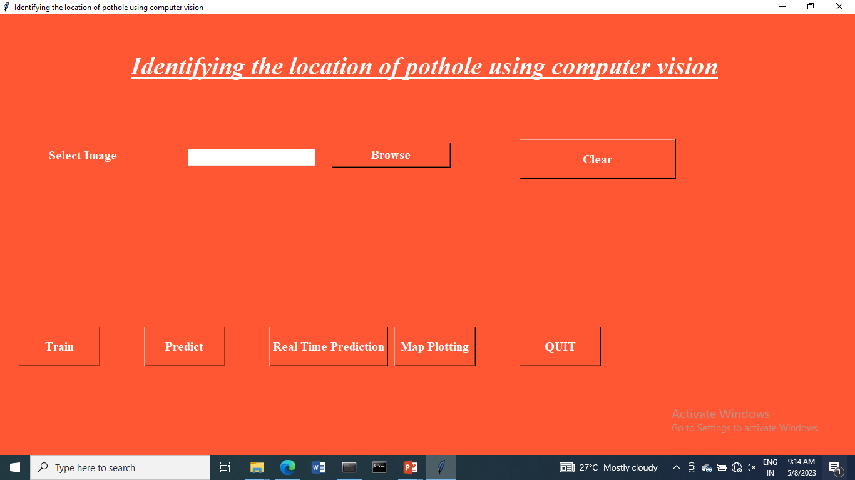
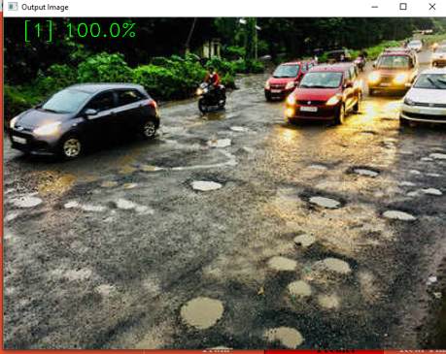
RESULTS

Slide 59
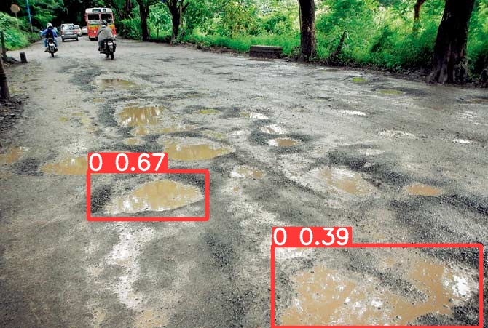
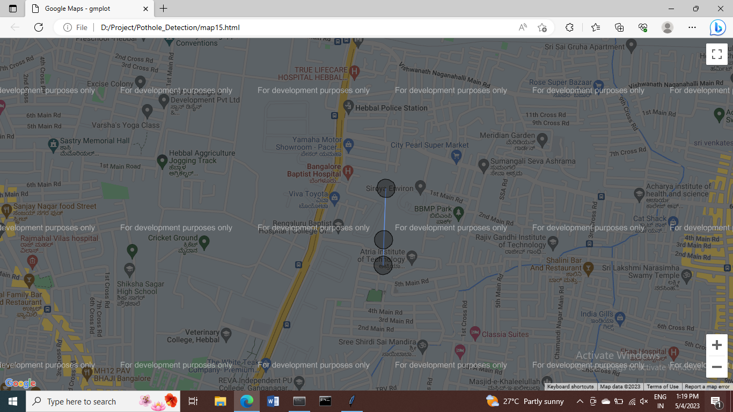
RESULTS

Slide 60
Thank you!

